Slide 1
Chinese Name（男）
1)伟奇（伟大、神奇）-greatness and miraculous
2)文博（文采飞扬，博学多才）be a brilliant man of wide learning
3)天佑（生来就有上天庇佑的孩子） Children are born with god blessing
4)明辉 （辉：光明 ） promising
5)伟诚 (伟：伟大 诚：诚实 ) greatness and honest
6)英杰（英俊杰出） Handsome and outstanding
7)国豪（国人因它而自豪）people proud of it
8)荣轩 (轩：气度不凡 ) distinguished
9) 浩宇 （胸怀犹如宇宙，浩瀚无穷） Heart is like the universe , vast boundless
10)皓轩 （意为：光明磊落，气宇轩昂） Aboveboard
11)哲瀚 (拥有广大的学问) With the general knowledge
12)博超 (博：博大 超：超越 ) erudite and surpass
13)君浩 (君：君子 浩：浩大 ) gentleman and vast
14)鹏涛 (鹏：比喻气势雄伟 ) imposing
15)建辉 (建造辉煌成就) build brilliant achievement

Slide 2
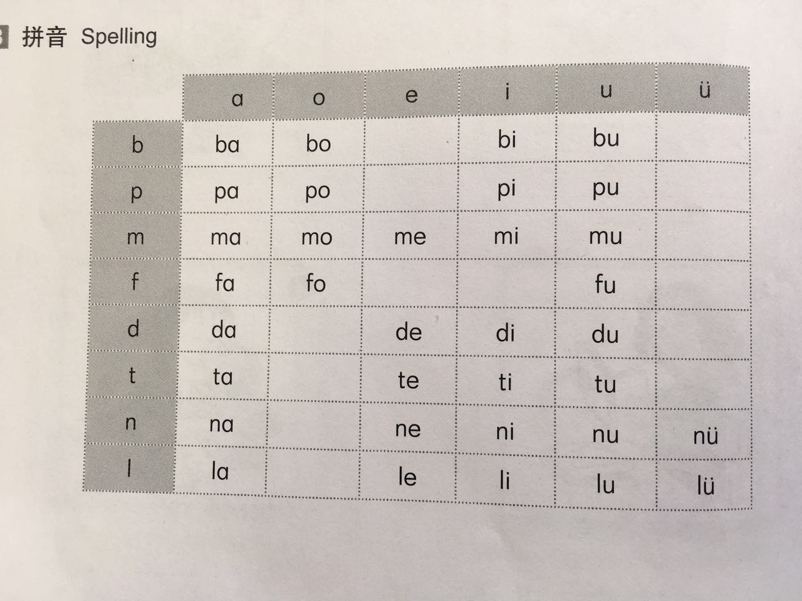
复习 Review
Initials
b p m f d t n l
Finals
a o e i u ü
er
Notes:
汉语的音节绝大多数是由声母和韵母组成。音节开头的辅音叫声母，其余部分叫韵母。A Chinese syllable is usually composed of an initial and final. The former is a consonant that begins the syllable and the latter is the rest of the syllable.
注：跟读练习

Slide 3
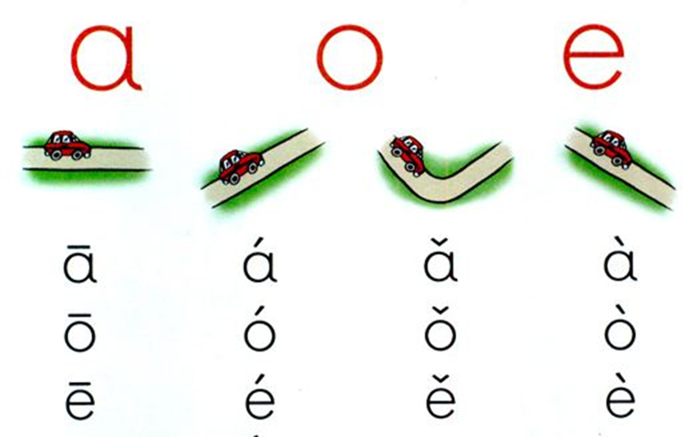
声调 Tones
Notes:
To thousands of Chinese characters, only these initials and finals is not enough. Here comes the most challenge part of Chinese sound system: tones. Each syllable in Chinese has as many as four different tones. The first tone is a high-pitched level tone and is represented by a horizontal bar over the vowel letter or the most salient(突出的) vowel letter in a syllable. The second tone is a rising tone, and its tone mark is a rightward up-going line. The third tone is a dipping(落下的，蘸，浸渍) tone. It starts low and goes even lower before going up. The third tone is indicated by a small tick. The fourth tone is a falling tone, and its tone mark is a short line going downward to the right.
(注：1.游戏练习：用双臂展示四种声调；
2.先学习一声和三声；再学习二声和四声

Slide 4
变调 Modulation of Tones
v＋v → ⁄ ＋v
Nǐhǎo → níhǎo lǎohǔ → láohǔ
Notes:
1.两个第三声的音节连在一起时，前一个要读成第二声。A third tone, when immediately followed by another third tone, should be pronounced in the second tone .

Slide 5
声调位置 Tone position
How to write the tone’s mark
1.If there’s “a” , put it on “a”.
2.If there’s no “a”, put it on “o” or “e” instead.
3.If there are “i” and “u”, put it on the latter one.
(When a tone-mark is placed above the vowel “i”,the dot over it should be omitted)
Exercise
ba mao qia biao
wo hou duo dong
te dei zhen sheng
yi tui diu
Notes:
注：1.听老师读，学生手臂表演并进行标注
2.一个学生读并用手臂表演，另一个学生进行标注。一个回合之后轮换。

Slide 6
Nínhǎo
您好
Hello

Slide 7
声母+韵母 The Combination of Initials and Finals
Initials
g k h
Finals
ai ei ao ou an en ang eng ong
Complete whole syllables
yi –wu- yu=i –u – ü

Slide 8
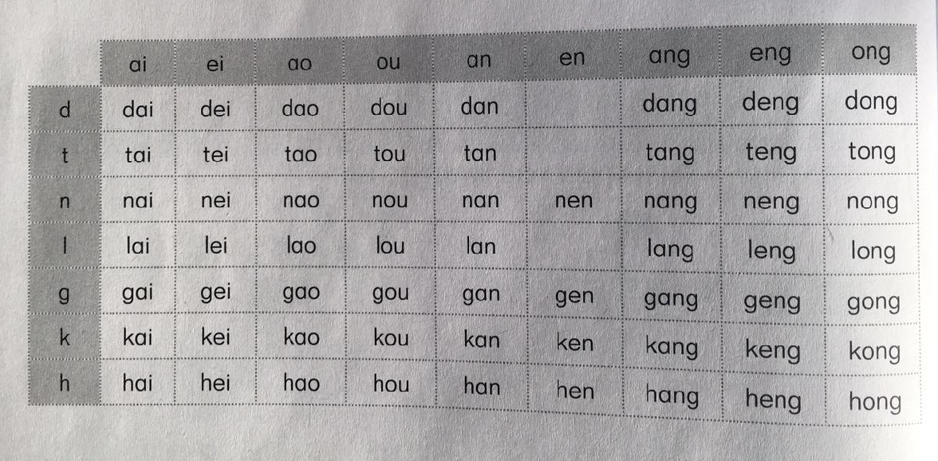
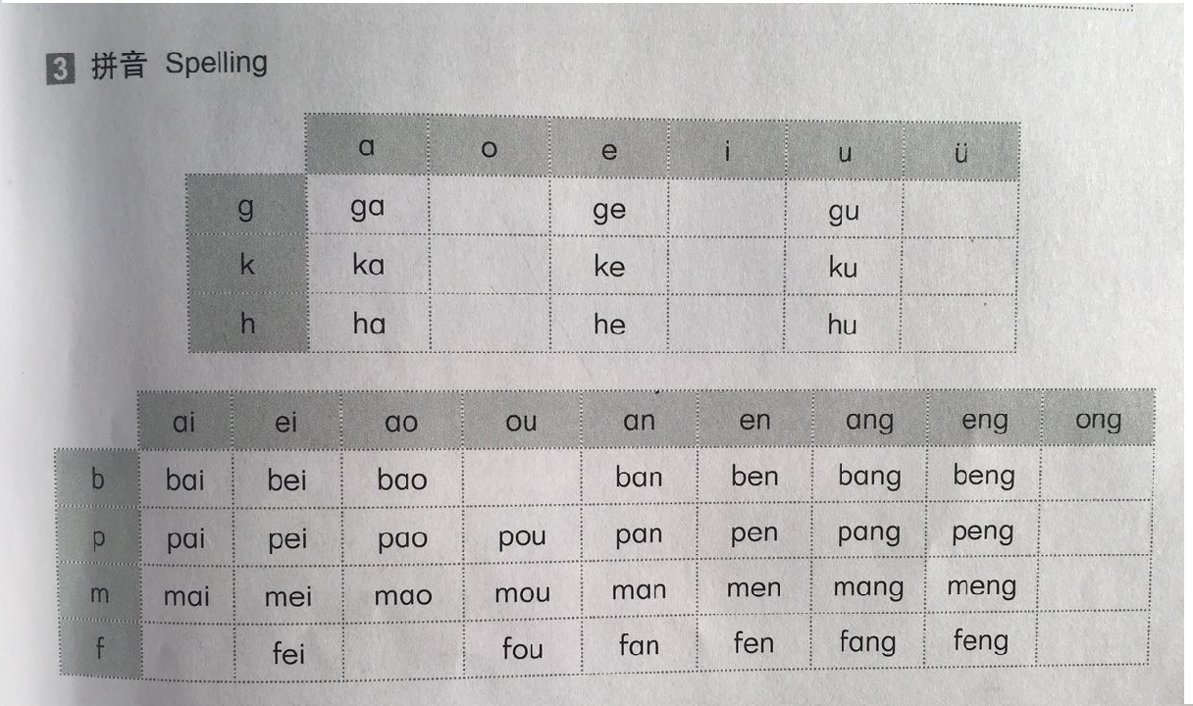
声母+韵母 The Combination of Initials and Finals

Slide 9
Phonetic drills
辨声母Initial discrimination
(1)gāi –kāi (2)hē-gē (3)gān-hān
(4)kōng-gōng (5)hǎo-kǎo (6)kěn-hěn
(7)tóugǎo- tóukǎo (8)mǐgāng-mǐkāng (9)hūhǎn-kūhǎn (10)hòuwèi-gòuwèi
辨韵母 Final discrimination
kěn-kǎn (2)gān-gāng (3)hòu-hòng
(4)hèn-hèng (5)gěng-gǒng (6)kǎo-kǒu
(7)mùpén-mùpéng (8)kāifàn-kāifàng
(9)gòule-gàole (10)bǎibù-běibù

Slide 10
Phonetic drills
辨调Tone discrimination
(1)fèn –fēn (2)máo-mǎo (3)lèi-lěi
(4)bāng-bǎng (5)gēn-gěn (6)hèng-héng
(7)hòufāng- hòufáng (8)kāifāng-kāifàng
(9)bānnòng-bànnóng (10)wǔdǎo-wǔ dào

Slide 11

Dictation Listen to the recording, and the fill in the blanks
（1） ___ǎ （2）___ěn （3）___ēi
（4） ___àn （5） ___āng （6） ___èng
（7） ___ù ___è （8） ___án ___ài （9） ___òng __ ào
（10） ___āng ___ǎi （11） ___áng ___ǎi （12） ___ōng ___uì
（13） m ___ （14）p ___ （15）t___
（16） l ___ （17）p ___ （18） d ___
（19） n___ h ___ （20） b___ b ___ （21） t ___d ___
（22） b ___ n ___ （23）m ___k ___ （24）d ___ p___

Slide 12
Express :
Dǎ zhāohu/Wènhòu
1. 打 招呼 / 问 候 Greetings
Dì-yī Cì Jiànmiàn
2.第一次见面 First Meeting
Shúrén Jiànmiàn
3. 熟人 见面 Acquaintance Meeting
Gàobié
4. 告 别 Farewell

Slide 13
1.打招呼 Greeting
1.生词 New Words
您nín you(singular; honorific)
你nǐ you(singular)
好hǎo good; fine
你好ní hǎo Hello
你们nǐmen you(plural)
老师lǎoshī teacher
早上 zǎoshang morning
晚上 wǎnshang evening
谢谢xièxie to thank
不bù not
客气kèqi polite, courteous
不客气bú kèqi You’re welcome
对不起duìbuqǐ I am sorry
没关系méi guānxi Don’t mention it
请qǐng please
进jìn to enter
Notes:
复习:
1.三声+三声—二声+三声
2.轻声
学习：
1.“不”的变调，Changes of tones of “不”。“不”在第四声音节前。在第一、二、三声音节前仍读第四声。“不”is pronounced in the second tone when it precedes another fourth tone . But it is pronounced in the fourth tone when it precedes a first, second or third tone.

Slide 14

打招呼 Greeting
2.对话 Dialogue
(1) A: Níhǎo
你 好! Hello!
B: Níhǎo
你 好 ! Hello!
(2) Student (s): Nínhǎo
您好! Hello!
Teacher: Níhǎo/Nǐmen hao
你 好 ! 你们好！ Hello!
Notes:
1.你好
日常问候语。任何时间、任何场合以及任何身份的人都可以使用。对方的回答也应是“你好”
It is a common greeting. It may be used anywhere, at any time and by anybody “你好” . The answer to it from the person addressed to is also
2.“您”是“你”的敬称。“您”is a polite expression of “你”

Slide 15


打招呼 Greeting
（3）Zǎoshang hǎo
早 上 好 Good morning!
Xiàwǔ hǎo
下 午 好 Good afternoon
Wǎnshang hǎo
晚 上 好 Good evening!

Slide 16
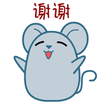
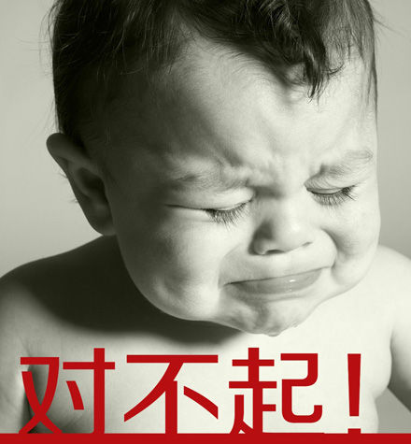
打招呼 Greeting
（4） A: Xièxie
谢谢 Thanks
B: Bú kèqi
不客气 You’re welcome
（5）A:Duìbuqǐ
对不起 I am sorry
B: Méi guānxi
没关系 Don’t mention it
（6） Qǐng jìn！
请 进 Please come in!
坐zuò to sit
听tīng to listen
说shuō to say
读dú to read
写xiě to write

Slide 17
问候 Greetings
1.生词 New Words
吗 ma a particle used at the end of a question
我 wǒ I , me
很 hěn very
呢 ne a particle used at the end of special,
alternative, or rhetorical question
也 yě too, also
爸爸 bàba father
妈妈 māma mother
都 dōu both, all

Slide 18
问候 Greetings
他们 tāmen they, them
他 tā he, him
她 tā she, her
爱人 aìren husband or wife
忙 máng busy
累 lèi tired
饿 è hungry
渴 kě thirsty

Slide 19
问候 Greetings
2. 对话 Dialogue
(1)A: Nǐ hǎo ma ?
A: 你 好 吗？
B:Wǒ hěn hǎo. Nǐ ne?
B:我 很 好。你 呢？
A:Wǒ yě hěn hǎo.
A:我 也 很 好。
B:Nǐ bàba māma dōu hǎo ma?
B:你爸爸 妈妈 都 好 吗？
A:Tāmen yě dōu hěn hǎo.
A: 他们 也 都 很 好。
ni gege
你哥哥
ni jiejie
你姐姐
ni airen
你爱人
ni airen
你爱人
tā
他
tā
她
tā
他
tā
她
Notes:
1.你好吗？
常用问候语。回答一般是“我很好”等套语。一般用于已经认识的人之间。
“你好吗” is a common greeting. One of the commonly used answer is “我很好”。It is used between people who have already met each other.
2.你呢？
“……呢” 承接上面的话题提出问题。
“……呢” is used to ask the same question as asked before.
3. 他们也都很好。
“也”和“都”只能用在主语之后 动词或形容词之前。“也”和‘“都”修饰同一个动词或形容词时，“也”用在“都”的前面。
“也”and “都”are only used before verbs and adjectives, after subjects. If “也” and “都” both modify the same verb or adjective, “也”should precede “都”

Slide 20
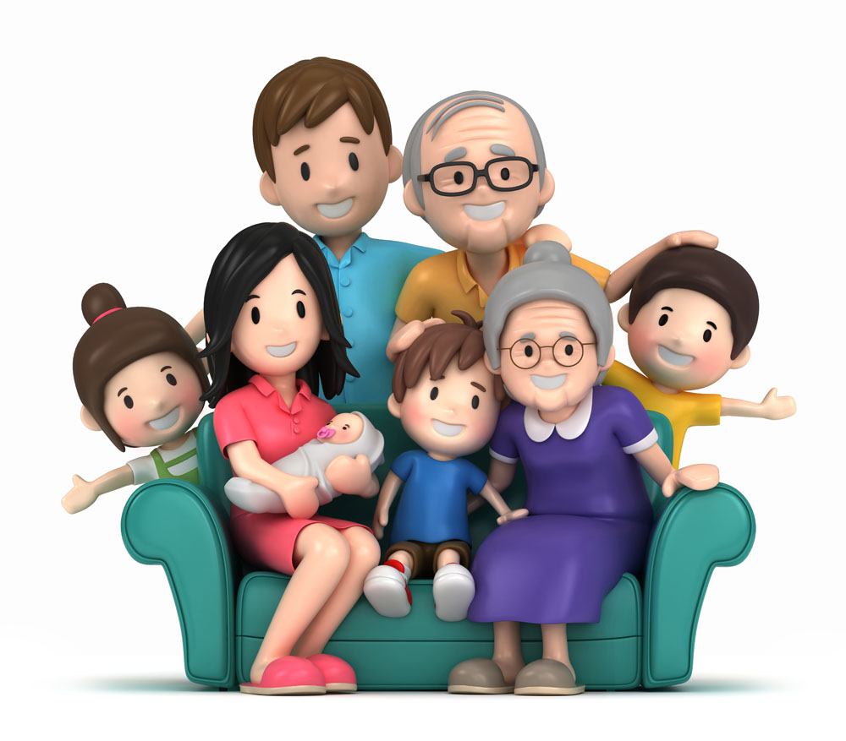
问候 Greetings
Family tree
bàba
爸爸
yéye
爷爷 grandfather
māma
妈妈
gēge
哥哥 elder brother
jiějie
姐姐 elder sister
dìdi/ mèimei
弟弟/ 妹妹
younger brother/younger sister
nǎinai
奶奶 grandmother
wǒ
我
me

Slide 21
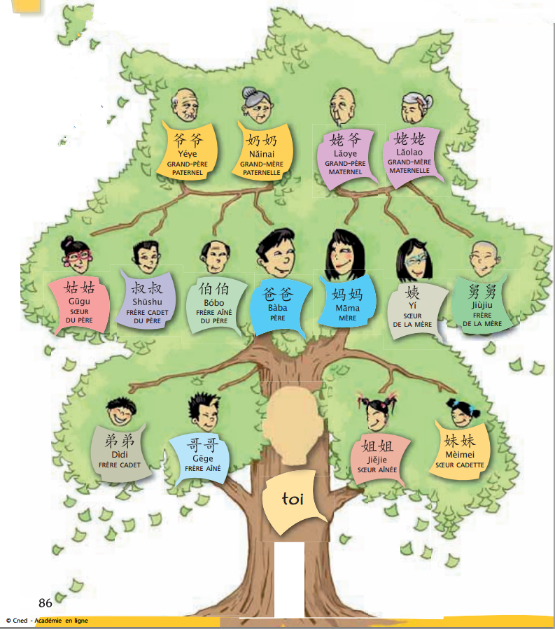
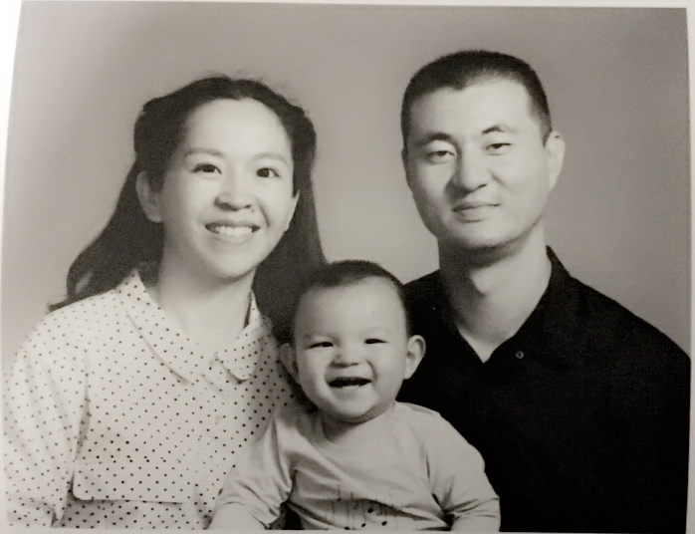
Family Tree

Slide 22
问候 Greetings
累 lèi tired
饿 è hungry
渴 kě thirsty
(2)A: Nǐ máng ma ?
A: 你 忙 吗？
B:Wǒ bù máng.
B: 我 不 忙。

Slide 23
2.第一次见面 First Meeting
1.生词 New Words
名字 Míngzi name
姓 Xìng surname; family name
中文 Zhōngwén Chinese
国家 Gúojiā country
法国 Fǎ guó France
留学生 Liúxuéshēng foreign student; overseas students

Slide 24
第一次见面 First Meeting
2. 对话 Dialogue
Nǐ jiào shénme míngzi?
你 叫 什么 名字？ What is your name?
Wǒ jiào zhāng xiǎo lù.
我 叫 张 晓 露。 My name is Zhang Xiaolu.
Nín shì nǎguó rén?
您 是 哪国 人？ What is your nationality?

Slide 25
第一次见面 First Meeting
对话 Dialogue
Nín jiā yǒu jǐ kǒu rén
您 家 有 几 口 人？ How many people are there in your family?
Rènshi nǐ hěn gāoxìng.
认识 你 很 高兴。 Nice to meet you!

Slide 26
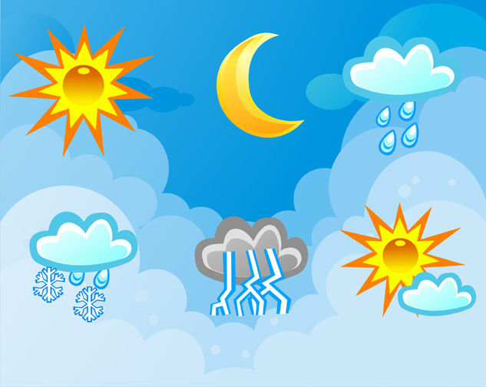
3.熟人见面 Acquaintance Meeting
1.生词 New Words
天气 tiānqì weather
今天 jīntiān Today

Slide 27
熟人见面 Acquaintance Meeting
对话 Dialogue
Jīntiān tiānqì zhēnhǎo!
今天 天气 真好！ The weather is really nice today!
Jīntiān zhēnlěng /zhēnrè!
今天 真冷／真热！ Today is really cold/hot!

Slide 28


4.告别 Farewell
1.生词 New Words
再见 zài jiàn bye
晚 安wǎn’an Good night
2.对话 Dialogue
(1)A: Wǎn’an !
晚 安
B: Wǎn’an !
晚 安
(2)A: Zài jiàn!
再见
B: Zài jiàn!
再见

Slide 29
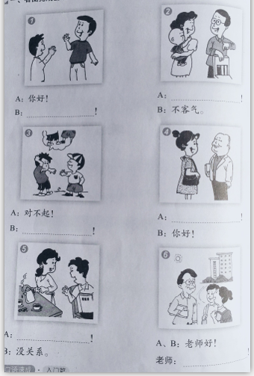
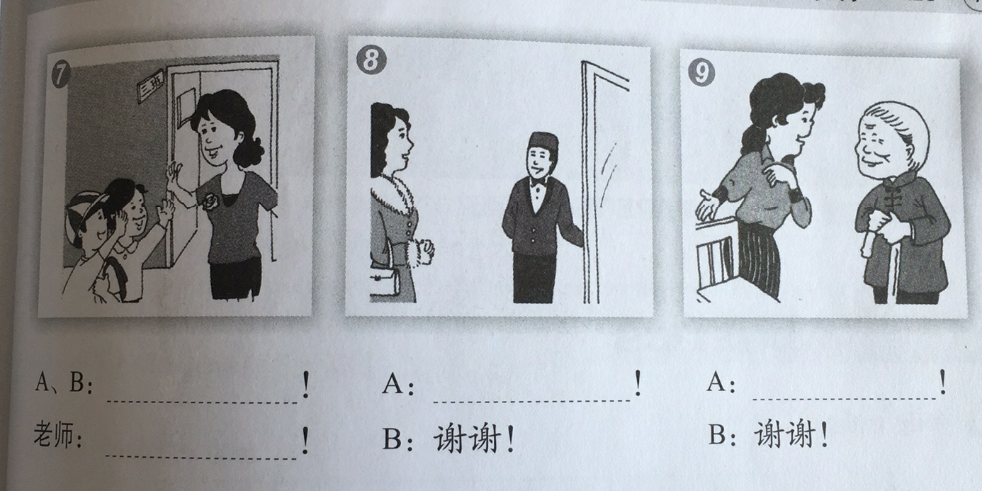
练习 Exercises
看图完成会话
Complete the dialogue according to each picture

Slide 30
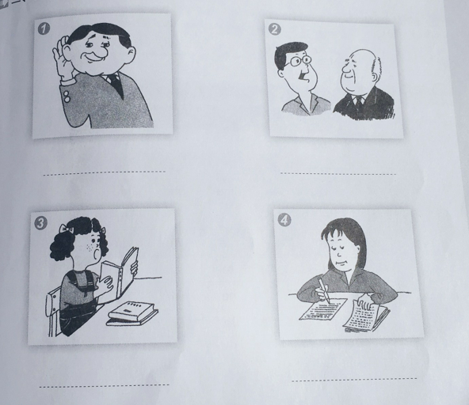
练习 Exercises
看图说动词
Give a Chinese verb for each picture

Slide 31
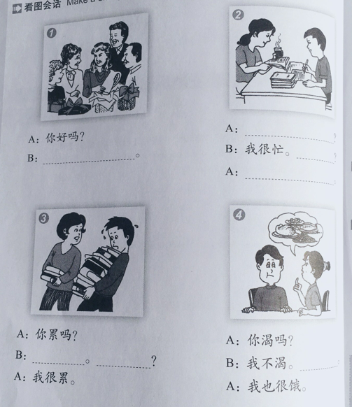
练习 Exercises
看图完成会话
Complete the dialogue according to each picture

Slide 32
小结 Summary
Pronunciation
Initials g k h
Finals ai ei ao ou an en ang eng ong
Complete whole syllables yi –wu- yu=i –u – ü

Slide 33
小结 Summary
Express:
Dǎ zhāohu/Wèn hòu
1. 打 招呼 / 问 候 Greetings
Dì-yī Cì Jiànmiàn
2.第一次见面 First Meeting
Shúrén Jiànmiàn
3. 熟人 见面 Acquaintance Meeting
Gàobié
4. 告 别 Farewell

Slide 34
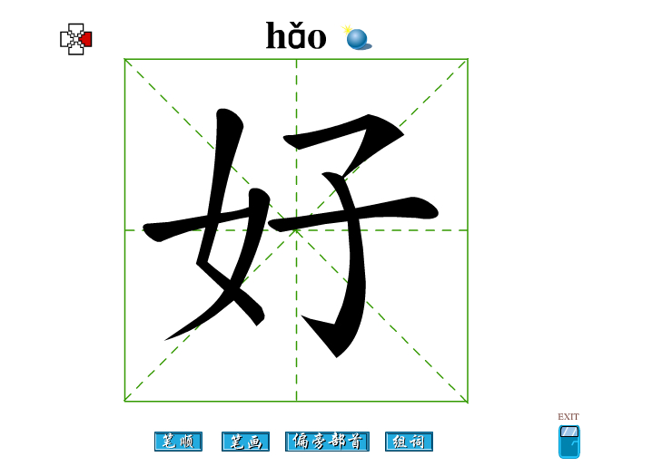
作业 Homework
1.Practice the dialogues we have learned this class, and perform them last week.
2.Show us a picture of your family and introduce the member of your family.
3.Practice write the Chinese character “好”
4. Practice write your Chinese name.

